Slide 1
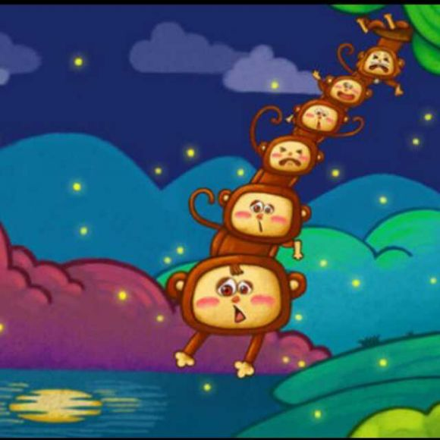
Monkeys Grasp for the Moon
猴子捞月
组员：王琛，张徐新懿，赵龙飞

Slide 2
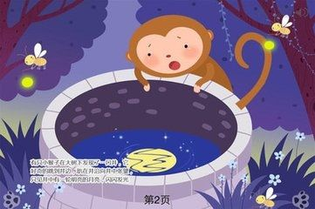
One day, a little monkey is playing by the well.
He looks in the well and shouts : “Oh !My god! The moon has fallen into the well!”
一天，有只小猴子在井边玩儿。它往井里一瞧，高喊道：“噢！我的天！月亮掉到井里头啦！”

Slide 3
An older monkeys runs over, takes a look,and says, “Goodness me! The moon is really in the water!”
一只大猴子跑来一看，说，“糟啦！月亮掉在井里头啦！”

Slide 4
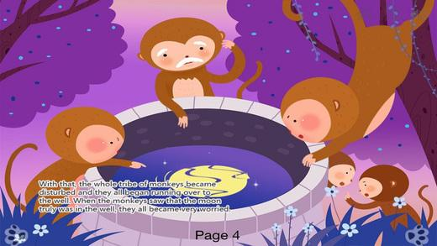
And olderly monkey comes over.He is very surprised as well and cries out: “The moon is in the well.”A group of monkeys run over to the well . They look at the moon in the well and shout:“The moon did fall into the well!Come on!Let’get it out!”
老猴子也跑过来 。他也非常惊奇，喊道：“糟了，月亮掉在井里头了！” 一群猴子跑到井边来，他们看到井里的月亮，喊道：“月亮掉在井里头啦！快来！让我们把它捞起来！”

Slide 5
Then,the oldest monkey hangs on the tree up side down ,with his feet on the branch .And he pulls the next monkey’s feet with his hands. All the other monkeys follow his suit, And they join each other one by one down to the moon in the well.
然后，老猴子倒挂在大树上， 拉住大猴子的脚，其他的猴子一个个跟着，它们一只连着一只直到井里。

Slide 6
Just before they reach the moon,the oldest m raises his head and happens to see the moon in the sky, 正好他们摸到月亮的时候，老猴子抬头发现月亮挂在天上呢
He yells excitedly “Don’t be so foolish!The moon is still in the sky!”
它兴奋地大叫：“别蠢了！月亮还好好地挂在天上呢！”

